Slide 1
Instructions for Completing Athletic Paperwork Online
Wesley Chapel High School

Slide 2
Visit www.athleticclearance.com

Slide 3
Click the FL image

Slide 4
-New User Select Create an Account tab -Pervious User Select Sign in

Slide 5
Complete Account Registration

Slide 6
Click Start Clearance Here

Slide 7
Year: select 2022-23 School: select Wesley Chapel Select Sport(s) you plan to participate

Slide 8
Complete all sections of the clearance form There are 7 sections that must be completed.

Slide 9
The following documents will need to be complete, signed, and uploaded.
Pre-Participation Physical (EL2)-must be completed and signed by a medical provider. If using a valid physical from 2021-2022 please upload the physical into the 2022-2023 Clearance.
Transportation Form
Participation Form
General Athletic Information for Students and Parents
Consent and Release from Liability Certificate (EL3)
Florida High School Athletic Association Clearance for Participation Form (GA7)
Additional for HOME SCHOOL STUDENTS ONLY - EL7 Verification Form
Additional for CHARTER SCHOOL STUDENTS ONLY - 2021-22 CSAP Forms

Slide 10
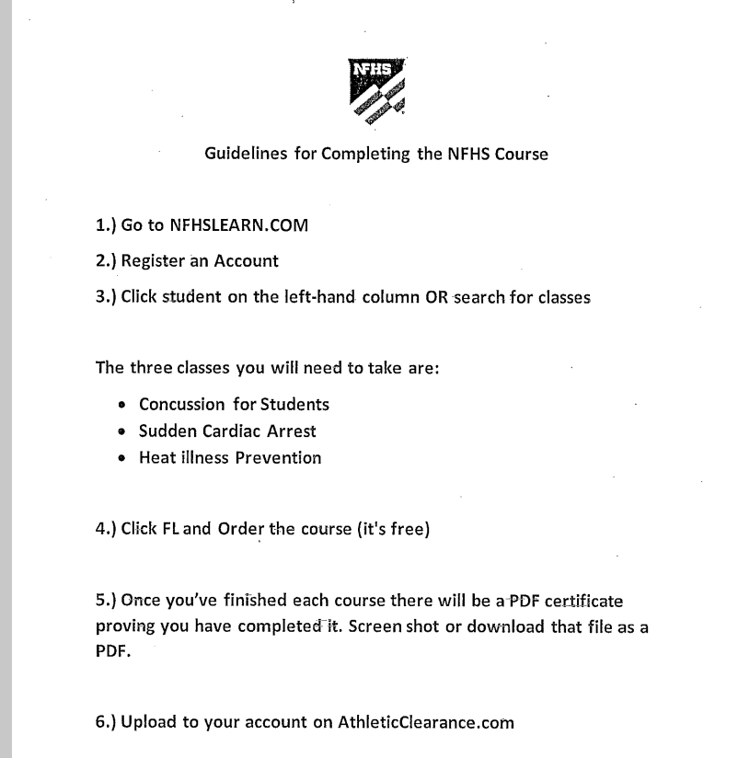
NFHS Course Registration
. https://nfhslearn.com/

Slide 11
Final
Print the “Confirmation Message” letter. This letter states that the process to participate in their sport at WCHS has been started. You will receive an email form Athletic Clearance once your student has been approved.
Print the email conformation
Provide an email copy to the Coach as verification that the Athletic Paperwork has been completed.

Slide 12
Certificates to Upload
Upload the following completion certificates
HFHS Concussion Certificate
NFHS Heat Illness Prevention Certificate
NFHS Sudden Cardiac Arrest Certificate

