Slide 1
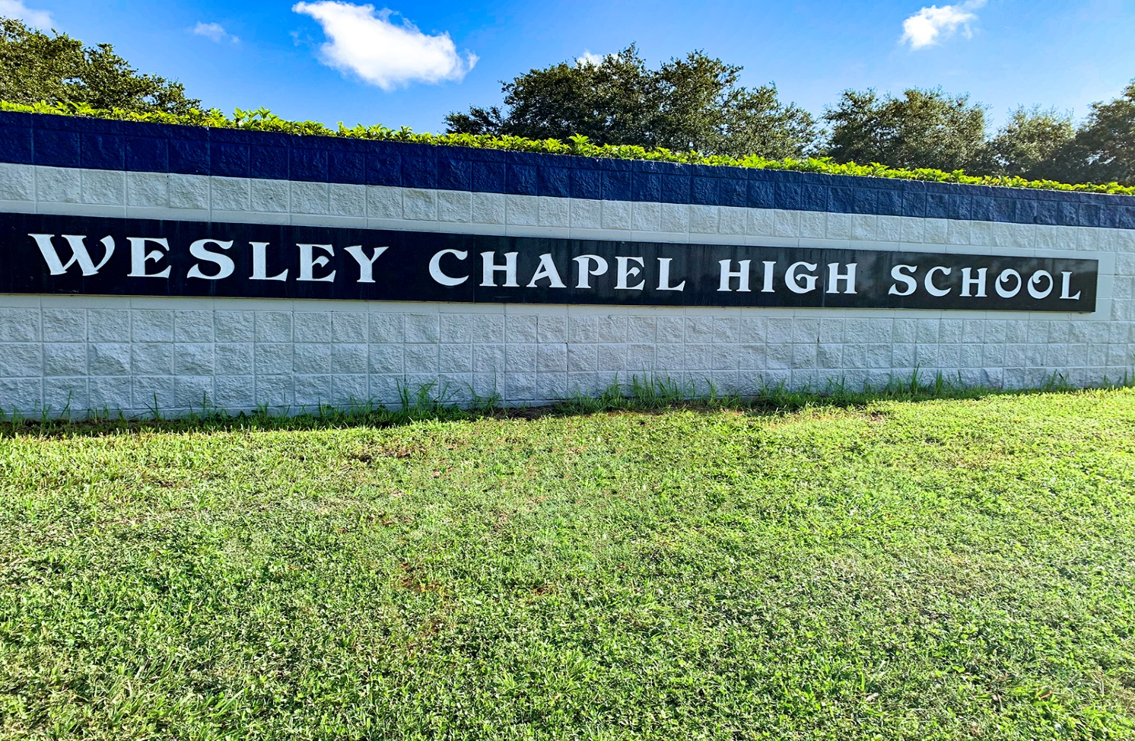
Welcome to Wesley Chapel High School class of 2030

Slide 2
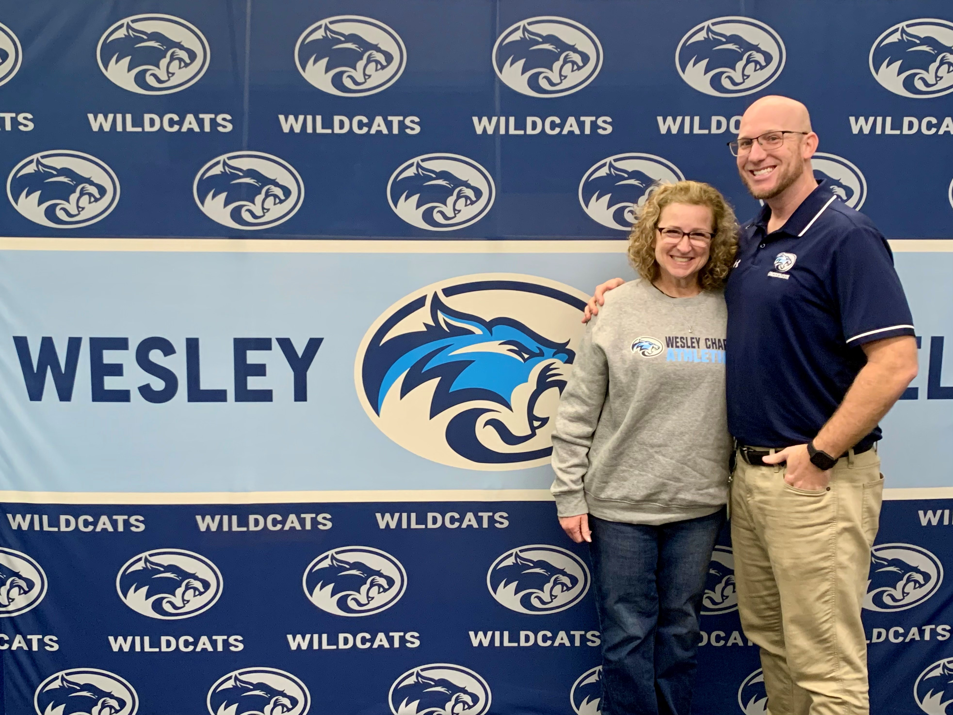
Your 9th Grade Team
Mr. Hayes - 9th grade Asst. Principal
mhayes@pasco.k12.fl.us
Mrs. Taylor – 9th grade Counselor
ptaylor@pasco.k12.fl.us

Slide 3
The importance of freshman year

Slide 4
What changes in high schooL?
Classes are more rigorous
More opportunity for academic advancement (Honors/AP/DE)
Certification opportunities in specific subject areas
All semester grades will count toward a cumulative grade point average (GPA) and will appear on permanent transcript
If you fail a required course, you must take it again (credit recovery)

Slide 5
High School Graduation Requirements
Must complete 24 Credits
4 credits of English
4 credits of Math (Algebra 1 and Geometry are required)
3 credits of History (World History, US History, Economics, and US Government)
3 credits of Science (Biology required)
1 credit of HOPE or the equivalent
1 credit of Fine Arts
.50 credit Personal Financial Literacy
7.5 Elective credits (if planning to attend a university, take two years of the same foreign language)
Must Pass the 10th Grade FAST Reading Assessment and Algebra 1 EOC

Slide 6
9th Grade Success
Do the best you can!
Ask questions/get help!
Use time wisely – take advantage of tutoring opportunities and study halls.
Have good organizational skills and smart study habits!
Find fun and interesting ways to volunteer in the community or at school.
Build relationships with your teachers. (Recommendation Letters in the future may be needed)

Slide 7
Go to class prepared
Attendance is extremely important to the success of any high school student!! You must be here to learn! After 10 absences, privileges will be taken away.
Being prepared for class is also important. Students must bring textbook, paper, pens/pencils, notebook/binder, calculator, etc.
Not only should you be prepared for class, but you need to come to class with a “Successful Attitude”, and an open mind ready to learn something new!

Slide 8
Academic Success SurveY: Self-evaluation
Take a moment and ask yourself these questions…
On average how many minutes/hours a night do you spend on homework? *Compare this to time on phone/social media, xbox, playing sports, etc.
What time do you do your homework?
Do you have a quiet place to study?
Have you ever attended tutoring?
How do you keep track of your grades?
Do I pay attention and participate in class?
Do I ask for clarification if I don’t understand something?
Have you ever asked for weekly progress reports?
Depending on the answer to these questions you may find areas where you could make adjustments to be more successful.

Slide 9
What to look forward to in High School…
Wide variety of courses to be taken – including courses for college credit!!
(Advanced Placement, Dual Enrollment)
Opportunity to attend Career Tech Center to learn a skill in a specific trade area!
Opportunities to be involved in numerous class and club activities!
Opportunities to be involved on an Athletic team!

Slide 10
Plan for success by…
Determining a goal- “I want to… graduate, go to college, go in the military…”
Developing a tentative plan to reach that goal.
Having a backup plan.
Considering all your options and revise the plan as needed.
Working hard – always keeping your goal in mind!
Being involved in your education!
Asking for help if you need it – use the resources available to you!!

Slide 11
Academies and Electives at WCHS
Next is a preview of a few of the academies and electives offered at WCHS!

Slide 12
AP CAPSTONE SCHOLARS diploma
Complete AP Seminar and AP Research courses and pass the exams with a 3 or higher
Requires two years of the same foreign language
Pass FOUR additional AP exams with a 3 or higher
(c/o 29 and beyond, must have three AP in core subject areas)
100 community service hours or 100 approved paid work hours (may combine to 100)
100% tuition/fees paid at Florida public university or state/community college
Renewable for four years (3.0 GPA)
AP exams can be taken through senior year. There is no GPA component for this award.

Slide 13
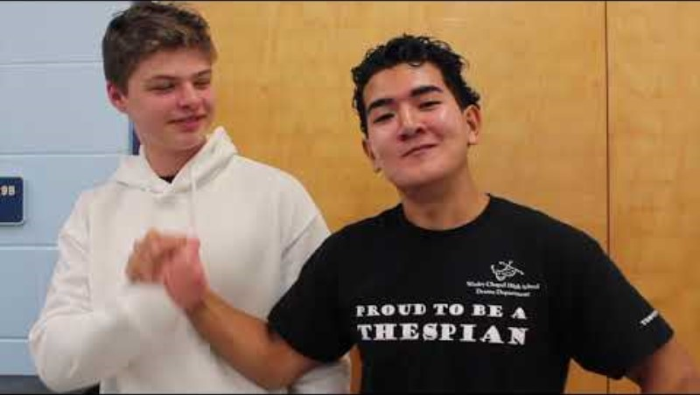

Slide 14
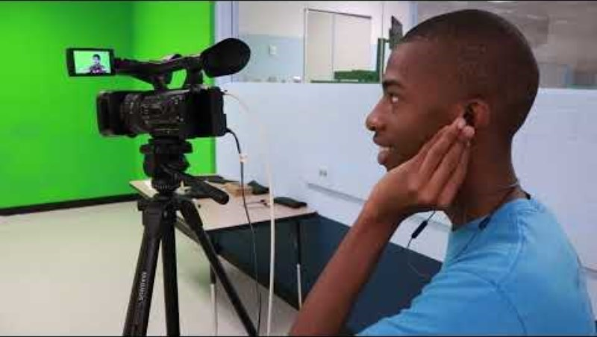
Drama

Slide 15
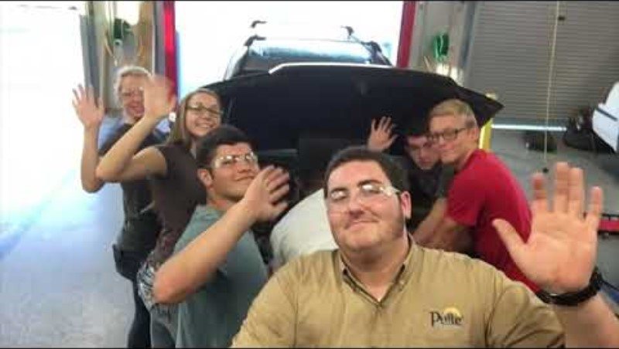

Slide 16
Academy of agriculture technology
https://youtu.be/mjyH9hn6TmE

Slide 17
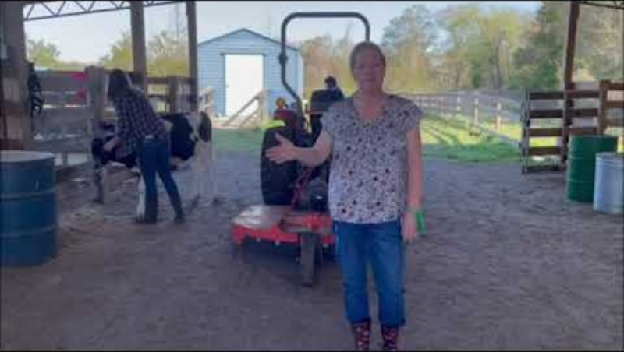

Slide 18


Slide 19

Mrs. Fay Geiger
fgeiger@pasco.k12.fl.us

Slide 20
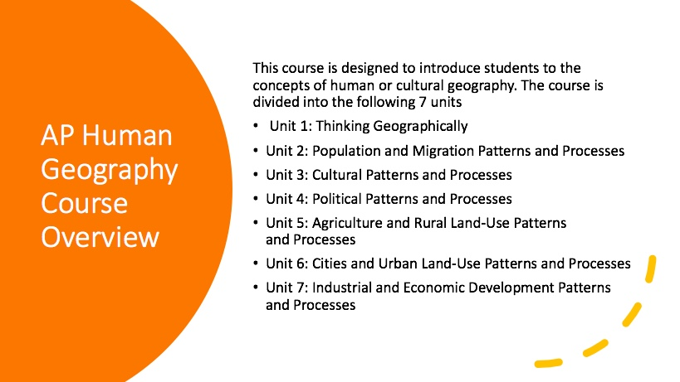

Slide 21


Slide 22

Questions

